Slide 1
Boost Your Program’s Health
by Adding Fibers to your Coroutine
CppCon 2017
David Sackstein davids@codeprecise.com

Slide 2
Thanks
Oliver Kowalke: Author of Boost Context, Boost Coroutines and Boost Fiber
Nat Goodspeed: Contributor to the libraries and author of proposals to ISO/WG21 for fibers and coroutines and speaker.

Slide 3
Agenda
Overview of coroutines
Two implementations: Stackless and Stackful
Generators
Asynchronous APIs
Threads and Fibers
The Boost Fiber library
Questions and Summary

Slide 4


Slide 5
More Information
Presentation and samples at: https://github.com/david-sackstein/CppCon2017
Boost Fiber documentation
My email: davids@codeprecise.com

Slide 6
What are Coroutines?
Coroutines are a generalization of subroutines.
Coroutines can be suspended and resumed. The resume at the point of suspension with the same state.

Slide 7
Use Cases for Coroutines
Generators, Parsers, Pulling from Visitors
Asynchronous APIs without callbacks
Combinations of the above: Asynchronous generators
What is common to all of the above?
Coroutines help us “Invert Control”
We allow the code that is called in a callback behave as if it were in control

Slide 8
Inversion of Control with Generators
Both Producer and Consumer want to be in the driver’s seat:
Producers want to call a function to transfer data
Consumers want to call a function to receive data
With coroutines:
The Consumer pulls data. The Producer is the coroutine (inverted):
The producer suspends on entry
Then pushes data and suspends.
Then resumes only when the consumer pulls again.

Slide 9
Two Coroutine Implementations
Coroutines TS:
Stackless
Suspend by return
Boost Coroutine2
Stackful
Suspend by call

Slide 10
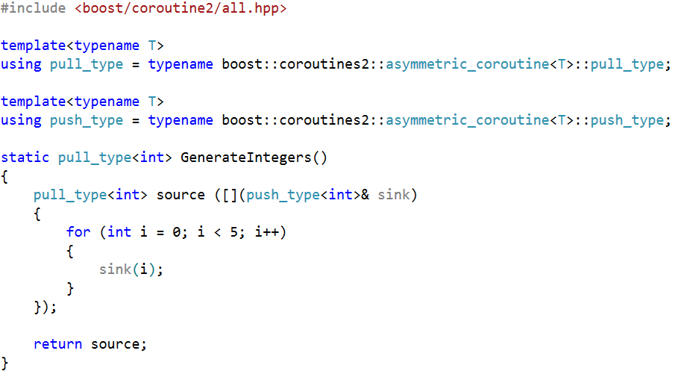
Generator using Boost Coroutine2

Slide 11
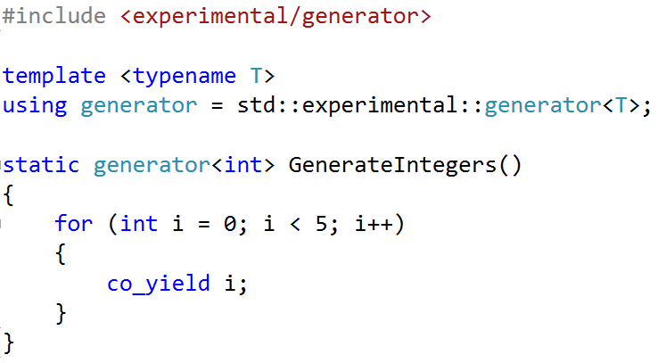
Generator using Coroutine TS

Slide 12
First class objects?
The generator is a first class object
Therefore generators can be chained together.
This is true for both coroutine implementations

Slide 13
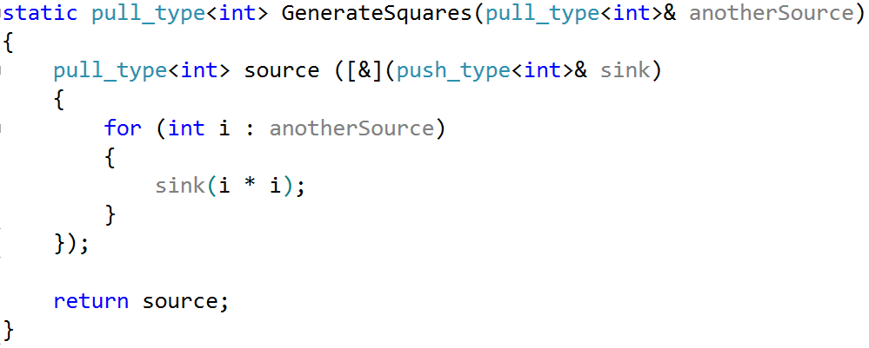
Chained Generator using Boost Coroutine2

Slide 14
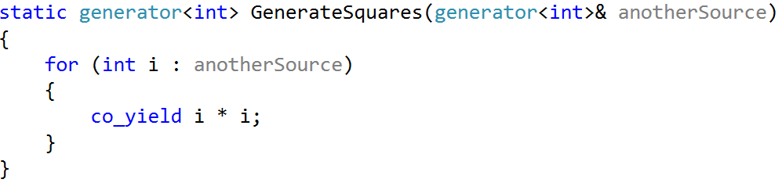
Chained Generator using Coroutines TS

Slide 15
First class objects?
The generator is a first class object
Therefore generators can be chained together.
This is true for both coroutine implementations
What about the push capability? Can that be passed around?
In Boost Coroutine2 the push_type can be passed around.
But in Coroutines TS we do not have access to a push object – the coroutine invokes a key word (co_yield) not an callable object.

Slide 16
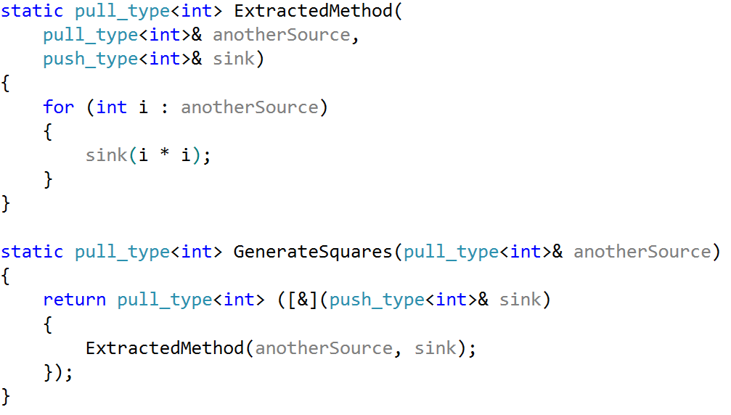
Nested Generation with Boost Coroutine2

Slide 17
Implications of Stacklessness
Resumable functions require less memory on initial call and in some cases, the heap allocation can be elided and the code inlined
However
Where generators are nested, nested iterations are required
As they suspend by return all functions that invoke a coroutine must be aware that the callee may suspend.

Slide 18
Implications of StackFullness
Boost Coroutine2 coroutines needs to allocate a stack on the initial call. Still, stack allocation can be customized using the Boost Coroutine2 library.
Because they suspend by call
Suspension is transparent to the caller.
This makes it easier to introduce coroutines to legacy code.
Nat Goodspeed demonstrates this in his C++Now 2016 talk: Pulling Visitors
Another example, a SAX puller

Slide 19
Asynchronous IO
Not only IO – Any operation that takes time.
Caller should not block the thread. If it does, an expensive context switch occurs.
Instead we initiate the IO operation, install a callback and go and do something useful.
When the operation completes the callback is invoked and we pick up where we were upon suspension.

Slide 20
Problems with callbacks
Difficult to explain and to maintain
The business logic of the class is split up into disjoint functions.
State has to be stored and retrieved each time a callback is called.
Error handling is difficult.
In particular exceptions cannot be used
The problem requires inversion of control.
We would like the function and the callback to behave as they were in control.

Slide 21
Boost Asio
Provides a wrapper for synchronous and asynchronous use of sockets (and other OS facilities)
io_service implements the Proactor Pattern for asynchronous IO.
Christopher Kohlhoff, the author of the library, provides a generalized way to invoke asynchronous operations.
Callable objects are only one method of completion. The compiler can deduce different return types from handler types for coroutines, futures and more.

Slide 22
Coroutines and Boost Asio
The code shows how a boost asio system timer that is invoked asynchronously can be awaited upon.

Slide 23
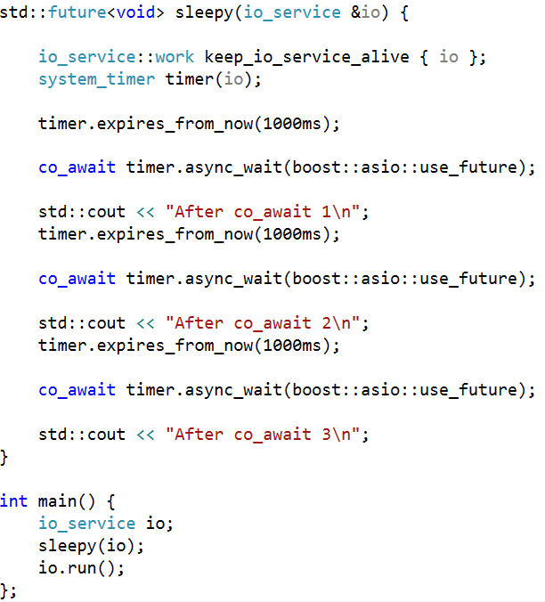
Coroutine TS implemented coroutine_traits<future<void>, _ArgTypes...>
Keeps io_service busy so it exits only after coroutine ends
Indicates to asio that the operation should return a std::future object.

Slide 24
From Threads to Coroutines To Fibers
The Echo Server Project
Four Parts
A. AsioSyncThreads
B. AsioAsyncCallbacks
C. AsioAsyncCoroutines
D. AsioAsyncFibers

Slide 25
The Echo Server Project
Implemented an EchoServer and a few EchoClients
Clients send a message, Server responds with the same message, Clients send the message they received and so on.
A Message is defined as a header indicating size and data of the specified size.
Writing a Message requires to writes and reading a message requires two reads.
We will zoom in on the Messenger object which reads and writes messages.

Slide 26
A. AsioSyncThreads
Blocking IO on a thread per connection

Slide 27
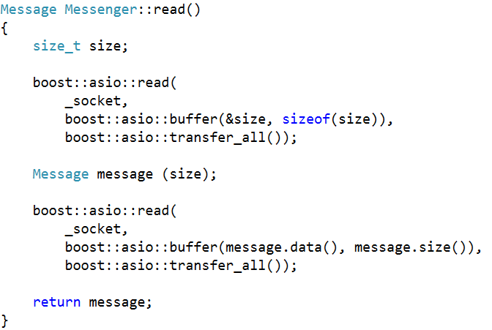
Reading a message synchronously

Slide 28
A. AsioSyncThreads
Blocking IO on a thread per connection
The Good:
Main thread listening for connections remains responsive
The Bad
Threads are expensive. Will not scale to thousands.
Context switching takes time and will dominate the server for large scales.

Slide 29
B. AsioAsyncCallbacks
Asynchronous IO using Boost Asio serviced by three threads (arbitrary number). The completion handlers are callback lambdas.

Slide 30
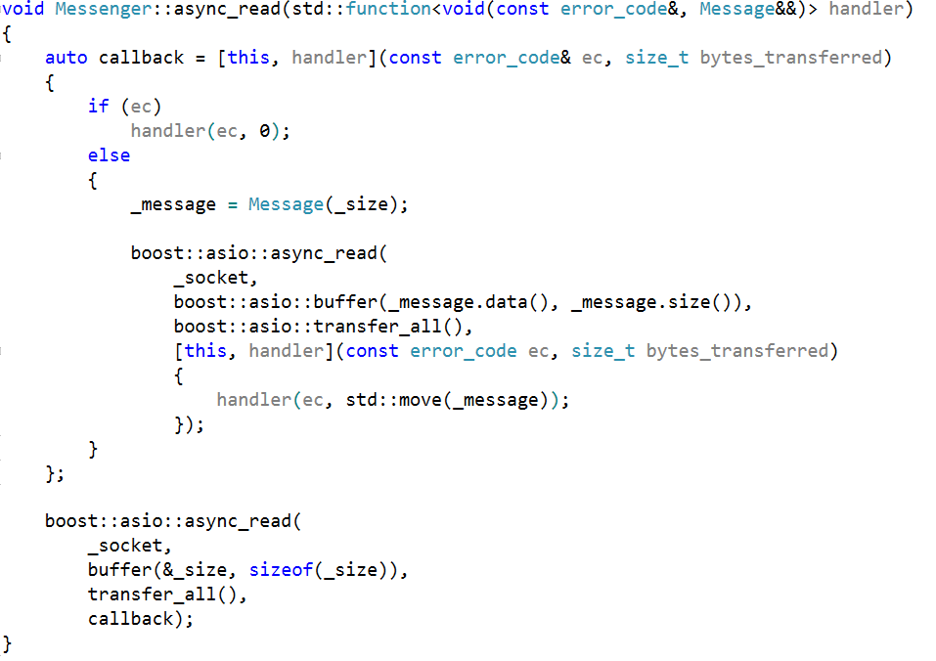
Reading a message asynchronously

Slide 31
B. AsioAsyncCallbacks
Asynchronous IO using Boost Asio serviced by three threads (arbitrary number). The completion handlers are callback lambdas.
The Good
Main thread listening for connections remains responsive
Scales well. The number of threads does not depend on the number of connections.
The Bad
Call back code is difficult to debug. Error handling is difficult

Slide 32
C. AsioAsyncCoroutines
Like B only asynchronous IO has been made to look like synchronous IO due to the use of coroutines.

Slide 33
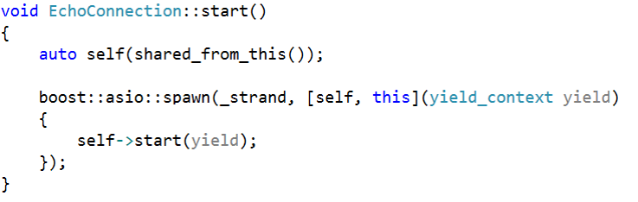
Asynchronously with Coroutine

Slide 34
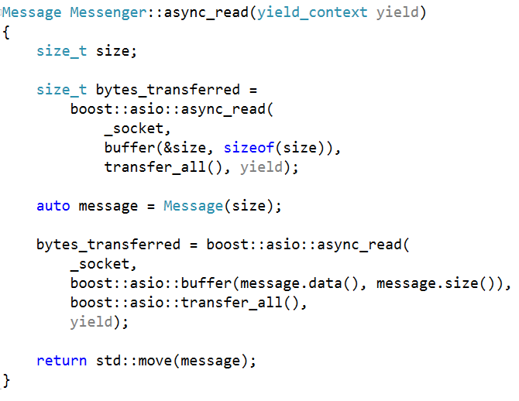
Asynchronously with Coroutine

Slide 35
C. AsioAsyncCoroutines
Like B only asynchronous IO has been made to look like synchronous IO due to the use of coroutines.
The Good
Main thread listening for connections remains responsive
Scales well. The number of threads does not depend on the number of connections.
The code is now organized like synchronous code.

Slide 36
Introducing the Boost Fiber Library

Slide 37
Boost Fiber Library Architecture
A fiber is a userland thread - a thread of execution that is scheduled cooperatively.
The library is organized as coroutines plus a manager plus a scheduler.
Each fiber has its own stack.
Like Boost Coroutine the library uses Boost Context to allocate and switch between stacks.
You can choose the stack allocation strategy. The default is fixed size. The size itself is configurable.

Slide 38
Fiber vs Thread
At most one fiber on a thread can be running
Therefore a fiber does not need to protect resources from other fibers running on the same thread.
However, if a fiber on another thread access the resource – protection is required.
Spawning fibers does not distribute your computation across more hardware cores.
But fibers do help you manage the division between working and waiting on a thread.

Slide 39
Manager
A fiber can be in the running, suspended or ready state.
The running fiber can call the manager to yield or suspend itself.
When a fiber yields it moves to the ready state
When a fiber suspends it moves to a suspended state.
In both cases the manager uses a scheduling algorithm to select another ready fiber to run.
The manager performs a context switch to the selected fiber.
If there were no ready fibers, the manager blocks the thread.
Context switching is direct, the manager runs on the source fiber.

Slide 40
Scheduler Algorithm
There is one scheduler algorithm for all fibers in a thread
The scheduler’s responsibility is to pick one of the ready fibers that should to run.
The default is a round robin scheduler among the ready fibers on the thread.
So, by default a fiber will always be resumed on the thread where it was created.
A blocked fiber can however be awoken by another thread

Slide 41
Scheduler Algorithm
The scheduling algorithm is an extension point. You can also implement and install your own.
You can also install others provided by the library for instance:
shared_work: ready fibers from all threads are treated equally
work_stealing: local ready fibers are selected if any, otherwise a fiber is stolen from another scheduler
Note that these algorithms migrate fibers between threads which requires care in protecting shared resources

Slide 42
Fiber Suspension
A fiber can yield itself or it can suspend itself (a.k.a. block) in a number of ways:
It can request to sleep (until a time or for a specified duration)
Use fiber synchronization objects that are defined in the library.
The semantics of the synchronization objects are are similar to those in the std::thread library, however:
The fiber types suspend only the current fiber. They do not block the thread (unless there are no other fibers to run)

Slide 43
Synchronization Object
Type | Comment
boost::fibers::mutex | Can be used with std::unique_lock
boost::fibers::condition_variable | No spurious wake ups
boost::fibers::barrier | Reusable fiber rendez-vous object
boost::fibers::future<T>, boost::fibers::promise<T> boost::fibers::packaged_task<T>
boost::fibers::buffered_channel<T> boost::fibers::unbuffered_channel<T> | Like a future-promise of a sequence of values

Slide 44
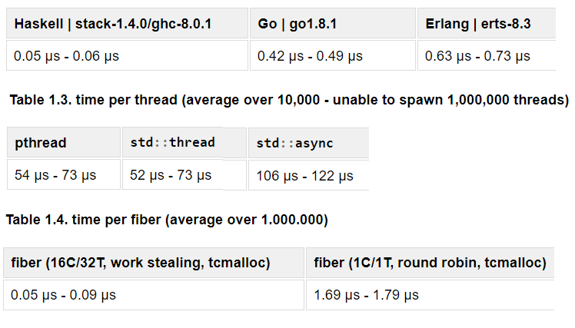
Context switching is fast*
* Boost Fiber Documentation

Slide 45
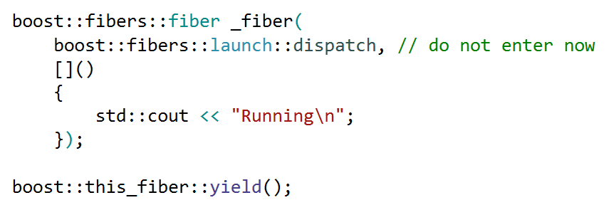
Launch a fiber

Slide 46
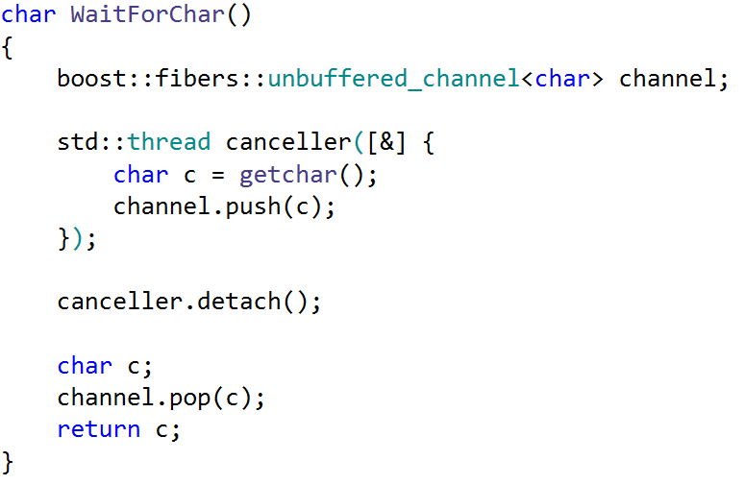
Using an unbuffered_channel

Slide 47
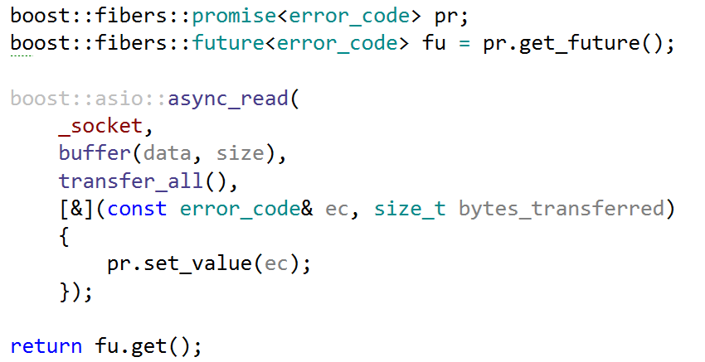
Using a future and a promise

Slide 48
D. AsioAsyncFibers
AsioAsyncFibers Like A only fibers are used instead of threads and asynchronous IO is used in combination with boost::fibers::future

Slide 49
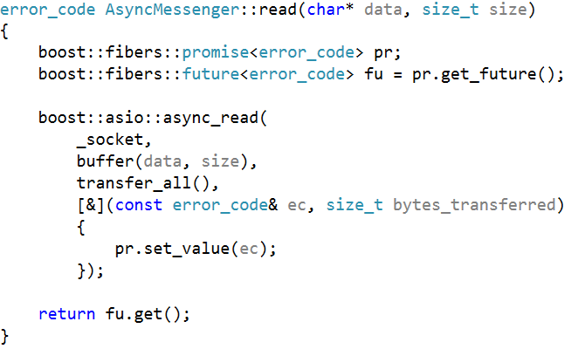
Asynchronously with Fiber
Blocks the current fiber only

Slide 50
D. AsioAsyncFibers
AsioAsyncFibers Like A only fibers are used instead of threads and asynchronous IO is used in combination with boost::fibers::future
The Good
All of the advantages of A-B
The Bad
Need to introduce grouping of connections on multiple threads.

Slide 51
Questions

Slide 52
Summary
We have two implementations of coroutines
Stackless (in standardization process) and Stackful (Boost)
Coroutines enable inversion of control
Generators
Asynchronous operations
Threads should be used for parallel computation (or for a small number of background tasks)
Fibers help organize the execution of asynchronous IO on a thread.

